Slide 1

DATA TYPES
TRAINING & RECRUITMENT
OFFSHORE DEVELOPMENT
IDENTITY MANAGEMENT
PORTAL DEVELOPMENT
APPLICATION DEVELOPMENT

Slide 2
Topics to be covered
Primitive Datatypes.
Non-Primitive Datatypes.
Arrays.
Variables: Local/Instance/Static/Reference Variables.
Operators and Expressions.

Slide 3
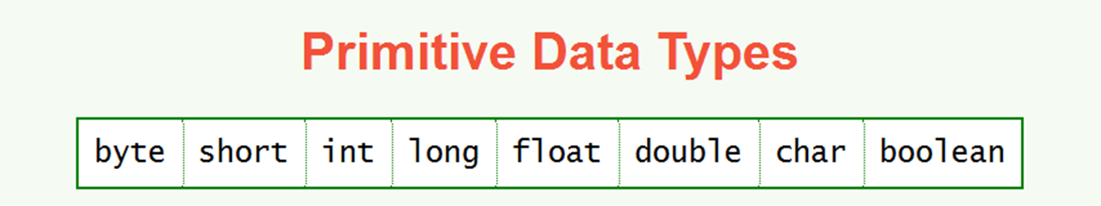
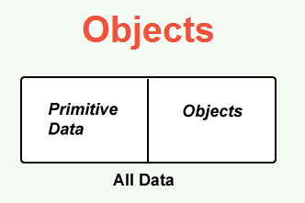
1. Primitive Data Types :
A primitive data value uses a small, fixed number of bytes.
There are only eight primitive data types.
A programmer can not create new primitive data types
An object is a big block of data, also may use many bytes of memory.
An object usually consists of many internal pieces.
The data type of an object is called its class.
Many classes are already defined in Java.
A programmer can invent new classes to meet the particular needs of a program.

Slide 4
2. Non-Primitive Datatypes
Are not defined by the programming language, but are instead created by the programmer.
They are sometimes called "reference variables," or "object references," since they reference a memory location, which stores the data.
In the Java programming language, non-primitive data types are simply called "objects" because they are created, rather than predefined.
While an object may contain any type of data, the information referenced by the object may still be stored as a primitive data type.
Ex:- int i1 = 10;
Integer i2 =Integer.valueOf(10);
int i1 is a variable of the primitive data type int, with the primitive int value of 10.
Integer i2 is a variable with a reference data type of Integer, referencing an Integer object which contains the value 10.

Slide 5
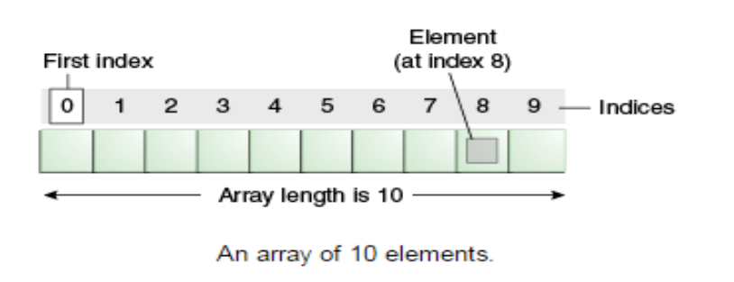
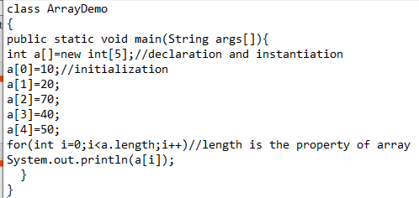
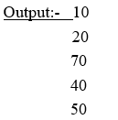
2. Non-Primitive Datatypes (Cont…)
ARRAY
Java array is an object(data structure) the contains elements of similar data type. We can store only fixed set of elements in a java array.
Array in java is index based, first element of the array is stored at 0 index.
It makes the code optimized, we can retrieve or sort the data easily.
We can get any data located at any index position.
Syntax: dataType[] arr; (or) Ex: int[] data = new int[10]; (or) int[] data = {23, 38, 14, -3, 0, 14, 9, 103, 0, -56 };
dataType []arr; (or) dataType arr[];

Slide 6
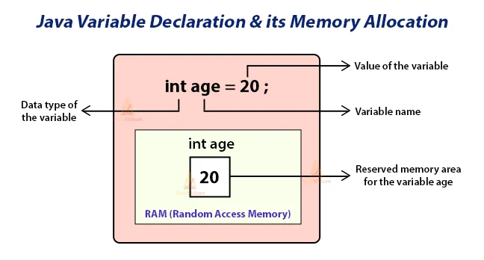
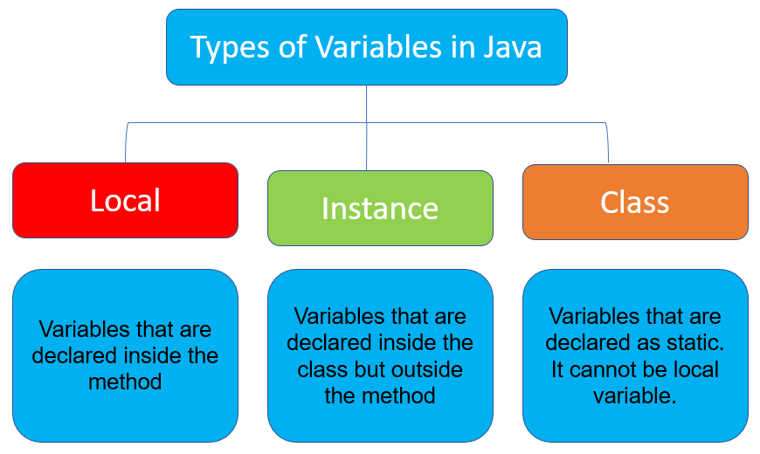
3. Variables
A named location in main memory which uses a particular data type to hold a value. Based on the data type of a variable, the operating system allocates memory and decides what can be stored in the reserved memory.
Name of the variable rules:
Use only the characters 'a' through 'z', 'A' through 'Z', '0' through '9', character '_', and character '$'.
An identifier can not contain the space character.
Do not start with a digit.
An identifier can be any length.
Upper and lower case count as different characters.
- SUM and Sum are different identifiers.
An identifier can not be a reserved word.
An identifier must not already be in use in this part of the program.

Slide 7
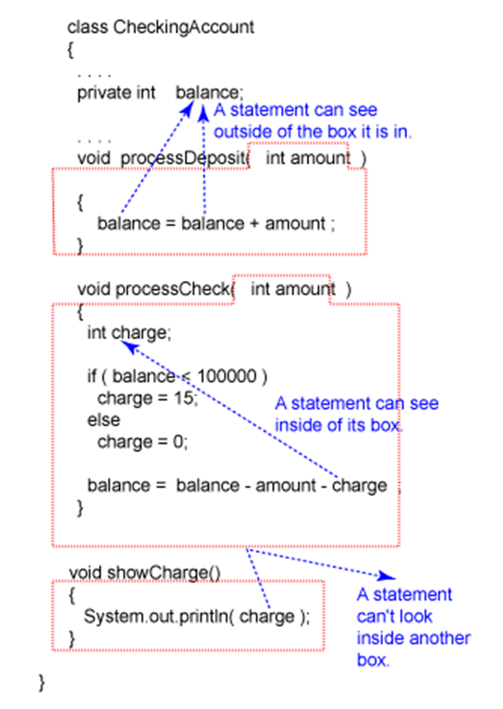
Variables – Local Variables
Local variables are created when the method, constructor or block is entered and the variable will be destroyed once it exits the method, constructor or block.
The scope of the local variable is limited to the method it is declared inside.
A local variable starts its lifetime when the method is invoked.

Slide 8
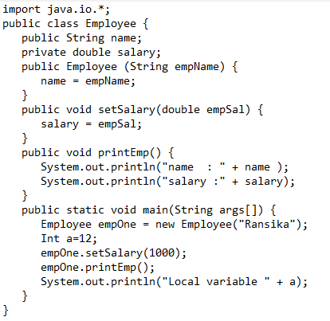
Variables – Instance Variables
Instance variables are declared in a class, but outside a method, constructor or any block without static keyword.
An instance variable is accessible throughout the class.
Used to store values that are needed to be accessed by different methods of the class.

Slide 9
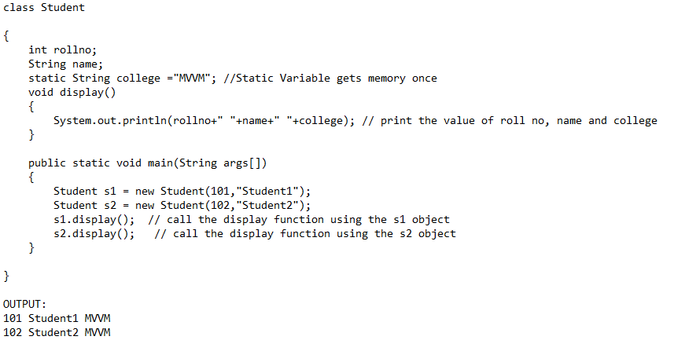
Variables – Static/Class Variables
Class variables also known as static variables are declared with the static keyword in a class, but outside a method, constructor or a block.
Static variables are created when the program starts and destroyed when the program stops..
Static variables only have one single copy of the entire class.
Used for storing constants.

Slide 10
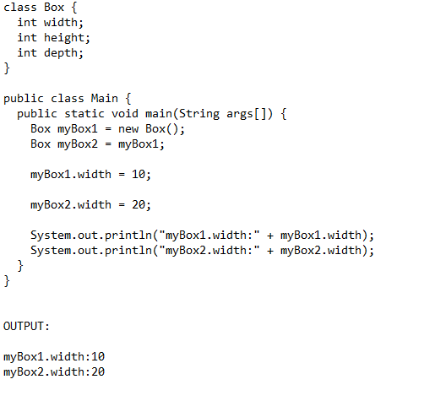
Variables – Reference Variables
A variable that holds reference of an object is called a reference variable. Variable is a name that is used to hold a value of any type during program execution. If the type is an object, then the variable is called reference variable, and if the variable holds primitive types(int, float, etc.), then it is called non-reference variables.

Slide 11
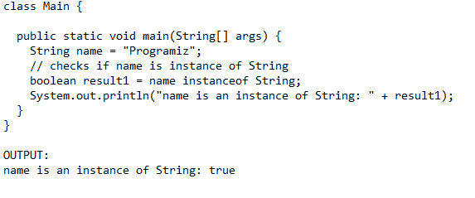
Operators & Expressions
Java provides a rich set of operators to manipulate variables. We can divide all the Java operators into the following groups:
Arithmetic Operators:- +,-,*,/,%,++,--
Comparison Operators:- == , != ,> ,< ,>= ,<=, instanceOf (The java instanceof operator is used to test whether the object is an instance of the specified type )
Logical Operators:- &&,||,!
Assignment Operators:- +=,-=,>=,<=,&=

